Slide 1
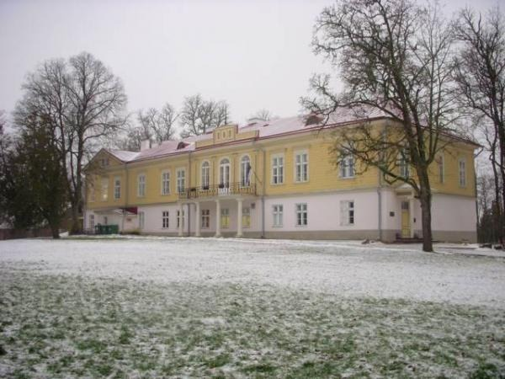
LEELO TUNGAL
and
RUILA

Slide 2
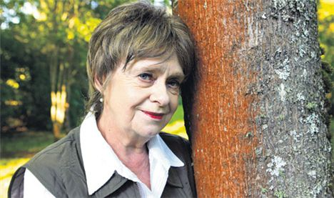
Why
First of all I will explain why I have made my report about Leelo Tungal.
?
why

Slide 3
Introduction
This is Ruila Basic School which functions in the old Ruila Manor house.

Slide 4
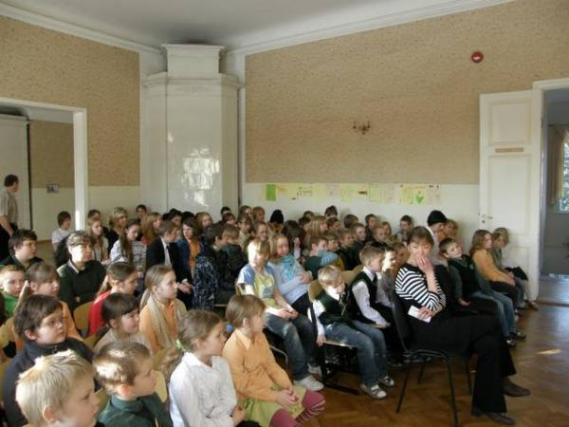
This is our big hall where all the festive meetings take place. At really important meetings we sing our school anthem. The author of the words is Leelo Tungal. She wrote the poem when she was in the 5th class in Ruila School.

Slide 5
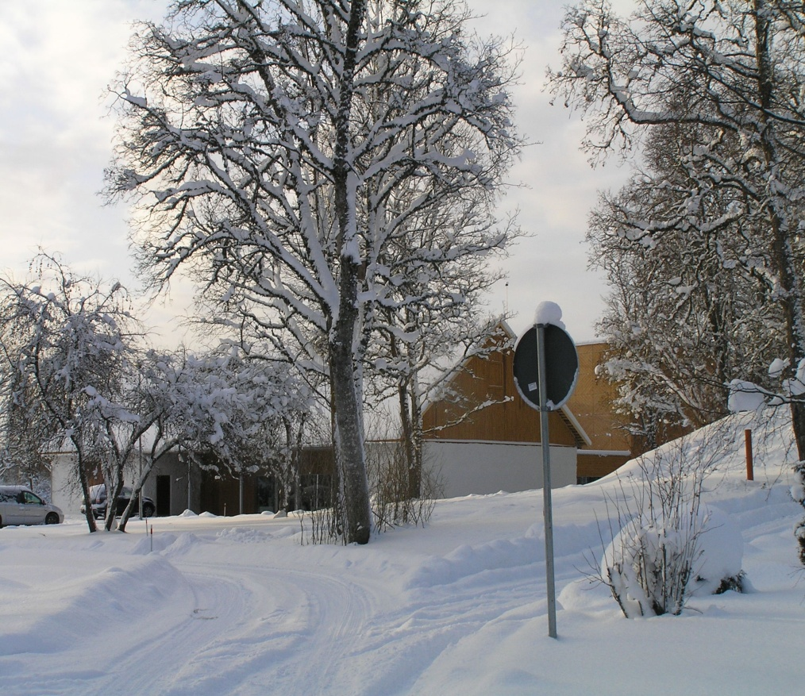
Leelo Tungal is closely connected with Ruila village and Ruila School.
I study in form 6 in Ruila Basic School, and as I also happen to admire the books written by Leelo Tungal, I have decided to write my report about this well-known writer.

Slide 6
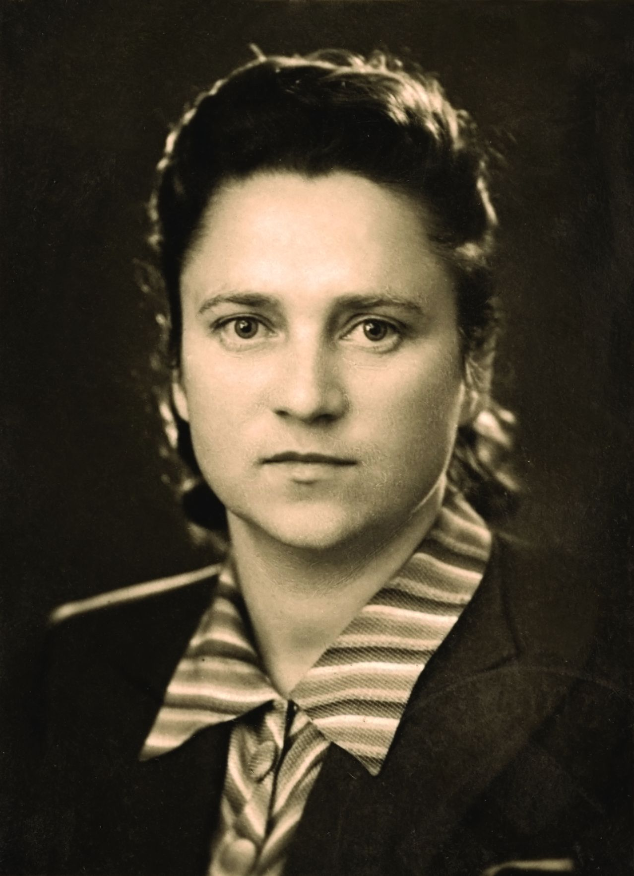
PARENTS Mother
Helmes Israel was born in 1907 on Äevard farm near Ruila. After graduating from Tallinn Teachers Seminary, she came back to her homeplace Ruila, where she started working as a teacher. In 1944 she married Felix Tungal, who was also a teacher in Ruila School. Helmes Israel was very active and beloved by the local people. She was arrested for political reasons in 1950 when Leelo was only 3 years old. After spending 5 years in Siberian prison camp, she returned to Ruila and worked as a schoolteacher until retirement.

Slide 7
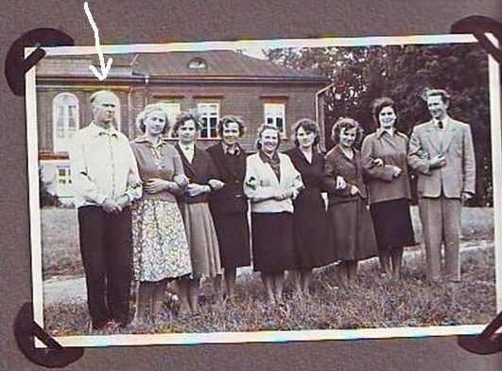
Father
Leelo’s father was a very active sportsman. He taught sports, art and music at Ruila school. His name was Felix in translation Lucky, and he was really lucky because he was not arrested. It is hard to over estimate the importance of father in Leelo’s education while both mother and one grandmother were in prison.

Slide 8
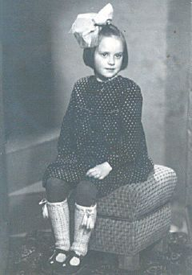
Childhood
Leelo’s childhood was connected with Ruila. She was born in 1947. The family used to live in the manor house. The beautiful manor served and still serves as a local school. Later they had to move into an old, cold house that was built for the farm hands and which is very near to the school. When she was a small girl she sometimes came to school together with her parents and she had to sit still in the classroom. She could read at the age of 4 already.

Slide 9
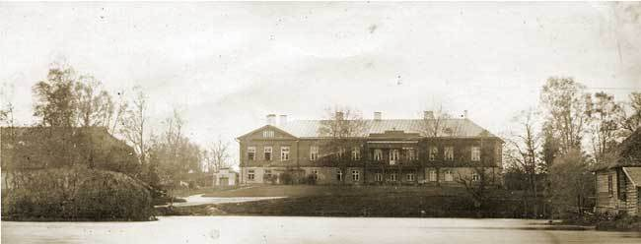
Studies
Leelo Tungal started her studies in Ruila Basic School.
She continued her studies in Tallin Secondary School nr.42.
She graduated from Tartu University as an Estonian language philologist in 1972.

Slide 10
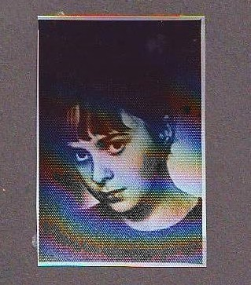
Teaching
Family traditions are very important. The first place to start her work after studies was of course in Ruila School.
Leelo Tungal has also taught children in Tallinn.

Slide 11
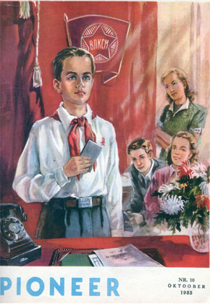
Career
Beside teaching Leelo Tungal has worked as an editor in “Täheke”, “Pioneer”, “Eestimaa” and “Hea laps”.
1981-1984 she worked in the Tallinn Puppet Theatre.
L.Tungal is best known and loved as a translator and writer.

Slide 12
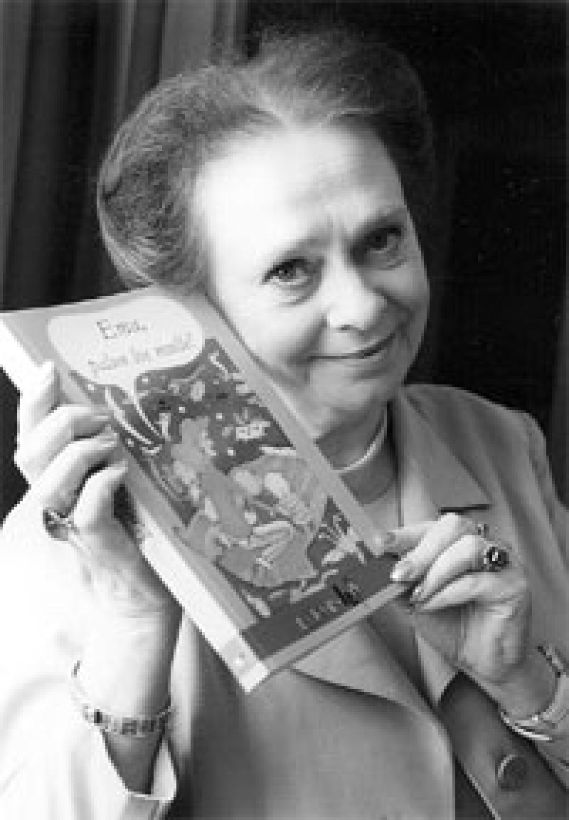
Creative works
Leelo Tungal has written poetry, prose, plays and librettos. She is extremely productive. Her books have been published nearly every year.
Among children she is best known as a wonderful poetess.

Slide 13
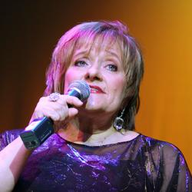
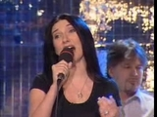
Eurovision
Many of her poems have been made into songs including those representing Estonia at the Eurovision Song Contest in- 1993 and 1994.
I.Must/ L. Tungal “Nagu merelaine”

Slide 14
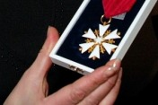
Awards
Children’s book award 1986
Award for children’s literature 1999
White star 4th class decoration 2005
Muhv’s award 2007
Harjumaa Culture Pearl award 2008
And several more awards
in poetry and literature.

Slide 15
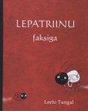
Books
Siil Felix ja sekelduste sügis(2005)
Lepatriinu faksiga (2004)
Lätikeelne jäätis(2006)
Seltsimees laps ja suured inimesed(2008)
Kirjad jõuluvanale(2001)
And many more.....

Slide 16
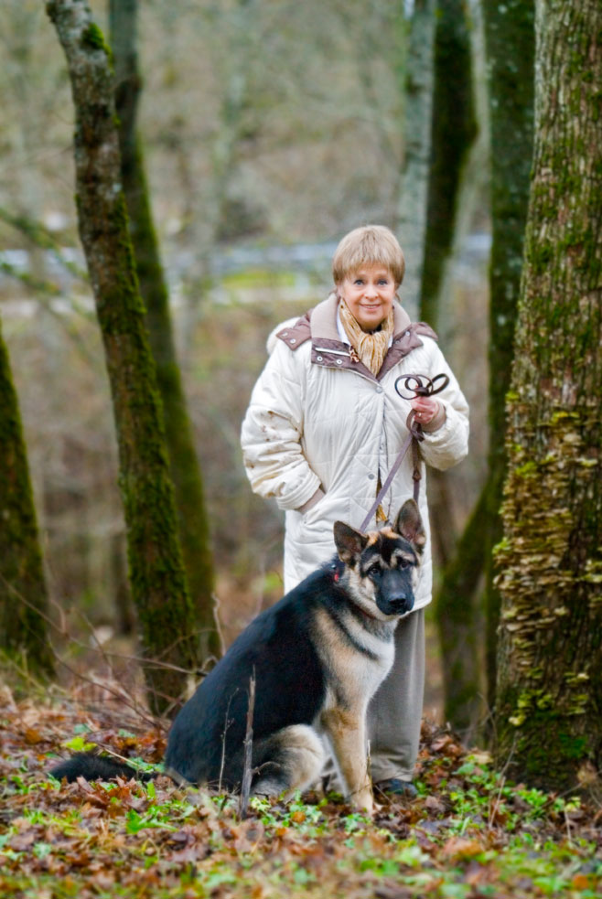
Leelo Tungal and Ruila Basic School today
Even today Leelo Tungal visits our school very often. She likes to talk about her books with children and everybody likes her stories about our school history.
She still lives next to our school house and we can often see her passing by.

Slide 17
Conclusion
I am very happy that I can meet Leelo Tungal on my schoolway. She is a living legend.
I hope you like and enjoy her books as much as I do.
I am eagerly looking forward to her future creation.

Slide 18
The End

